Slide 1


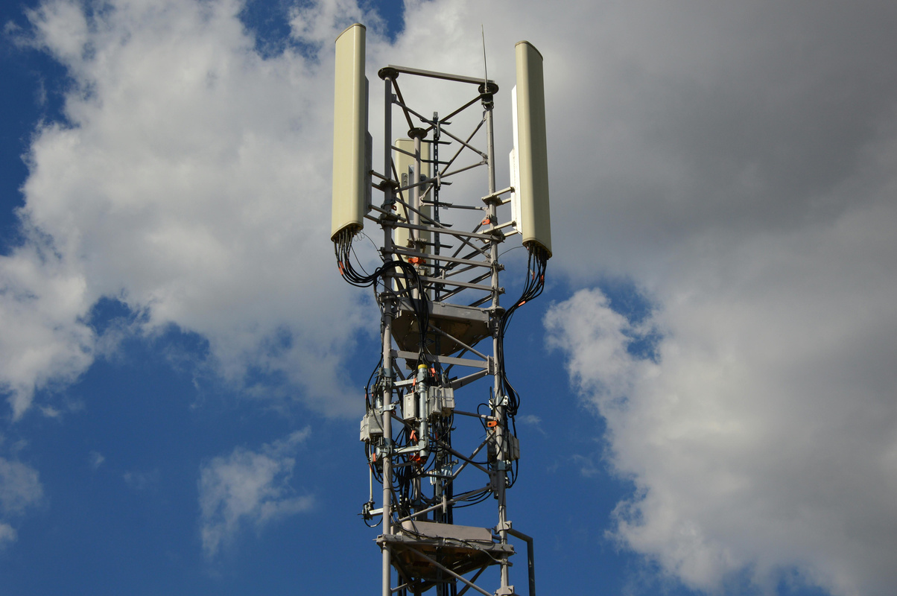


Atliq Telecom Analysis
PRE VS POST 5G BUSINESS INSIGHT

Slide 2
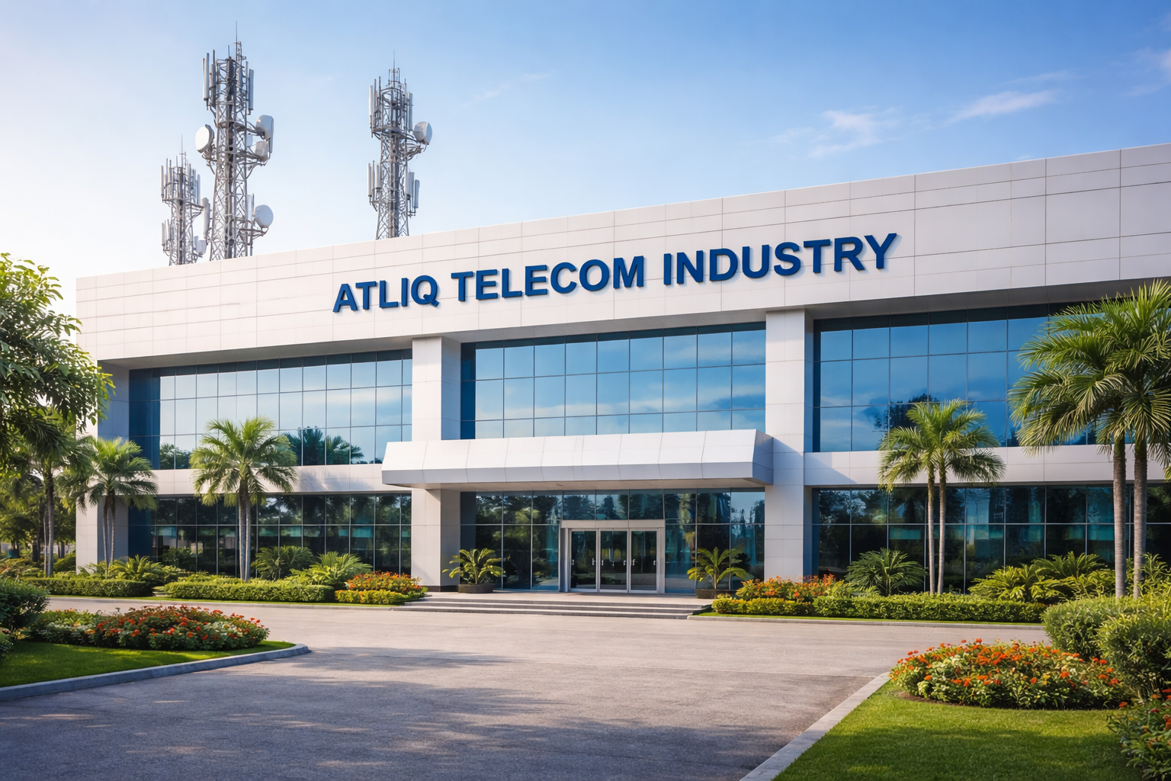
Introduction to Atliq Telecom
AtliQ operates in the Indian telecom industry
Provides mobile and high-speed internet services
Active in 15 major Indian cities
Key cities include Mumbai, Ahmedabad, Patna, Lucknow
Offers 4G and 5G internet plans

Slide 3
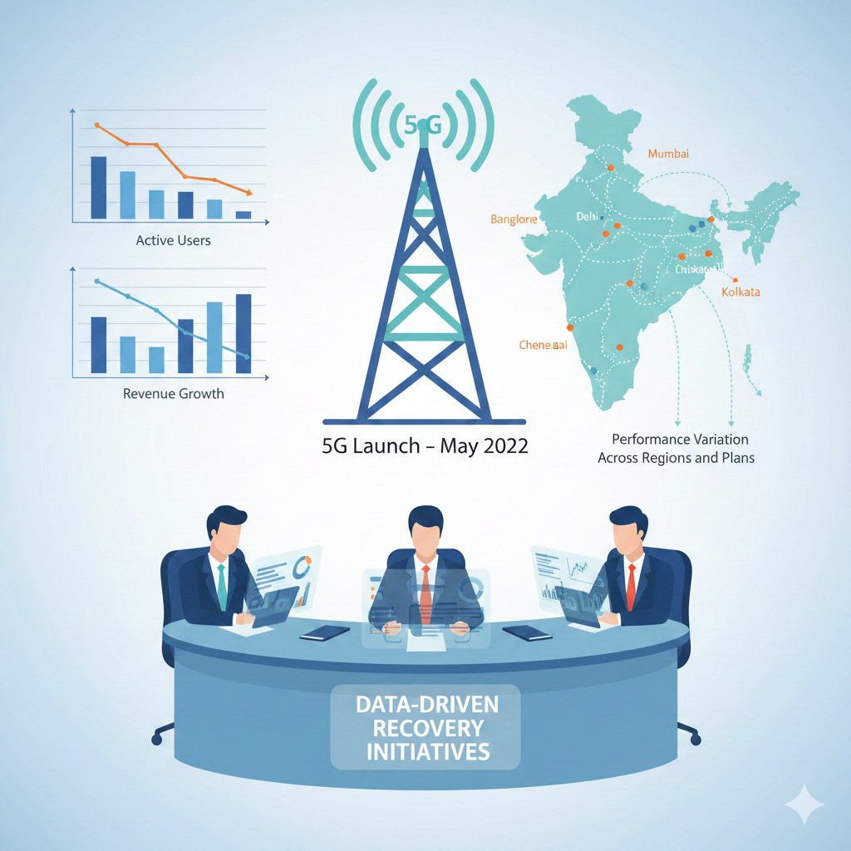
Problem Statement
5G services launched by AtliQ in May 2022
Decline observed in active users post 5G launch
Revenue growth slowed after introduction of 5G plans
Performance variation noticed across cities and plans
Management seeks data-driven insights for recovery

Slide 4


Goal Of Project
COMPARE PERFORMANCE BEFORE AND AFTER 5G LAUNCH
MEASURE IMPACT ON ACTIVE USERS AND REVENUE
DELIVER ACTIONABLE INSIGHTS FOR GROWTH RECOVERY
ANALYZE CITY-WISE AND PLAN-WISE TRENDS

Slide 5



Data & Tool Used
Data Source Files
Data Coverage Period
Tools Used
Excel for data storage, Power Query for transformation, Power BI for visualization
Excel files including dim_city, dim_plan, dim_date, and fact tables
Data from Jan to Sep 2022, excluding May due to 5G launch transition

Slide 6
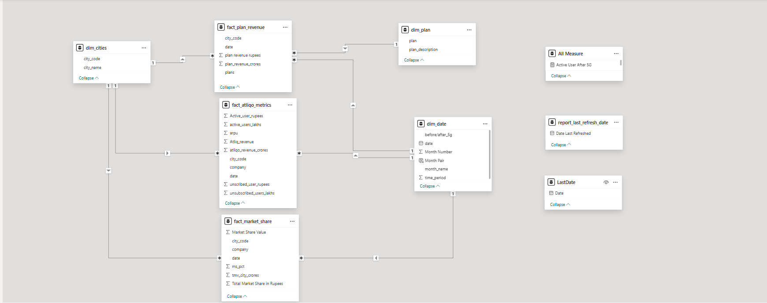
Data Modelling

Slide 7
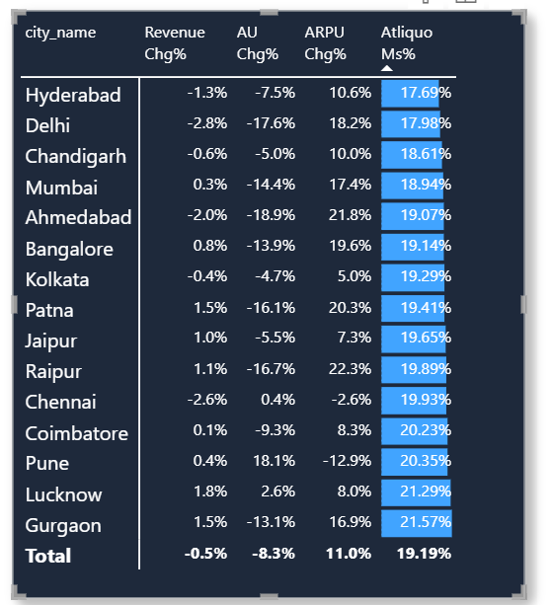
Strategic Insights & Actions
🔴 Category 1: High Priority Cities
Pattern: Active Users ↓ | Revenue ↓ | ARPU ↓ / Flat
Action: Entry-level plans, Special Offers
🟠 Category 2: Growing Users, Low Revenue
Pattern: Active Users ↑ | Revenue ↓ / Flat | ARPU ↓
Action: data add-ons, speed-based pricing
🟡 Category 3: High ARPU, User Decline
Pattern: ARPU ↑ | Active Users ↓ | Revenue ↓
Action: Affordable starter plans, trial offers, entry pricing
🟢 Category 4: Best Performing Cities
Pattern: Active Users ↑ | Revenue ↑ | ARPU ↑
Action: premium push, loyalty programs

Slide 8


